Slide 1
CSC 690 Capstone Project Stream Real Time Twitter Data & Analysis
Presented to: Prof. alex WU
Presented by: Anu Mehndiratta
Student Id: 92336

Slide 2
Agenda
Introduction
Configuration
Real Time Data Streaming.
Data Cleaning
Load data in Hive
Data Sentiment Analysis
Data Visualization via Tableau
Conclusion & References

Slide 3
Introduction
Social media has become one of the most powerful tools in recent times for marketing and research that help organizations grow their business
For this, we need to understand and analyze the data generated in the form of tweets, status updates etc.
In my project, I have plan to take real time twitter data with the requisite hashtags and provide useful results in the form of the number of users who tweeted using the hashtag, number of tweets containing media, number of tweets per users(celebrities or non-celebrities) etc. This data can very well be used in various data analysis models.

Slide 4
This project is divided in 6 parts (problems):
Get twitter data
Clean the Data
Load the data into HDFS
Convert the JSON data to Structured Data
Perform Analysis using Hive
Display the Results using Tableu

Slide 5
Configuration
Create Twitter Application
Create my Access token from Twitter site
Consumer Key
Consumer Secret
Access Token
Access Token Secret

Slide 6
Real Time Data Streaming
After successful connection with Twitter, will extract the real time data using Java program & load the data in HDFS system.
To stream the twitter data we need two jar files from twitter4J.org
Twitter Core
Twitter Stream

Slide 7
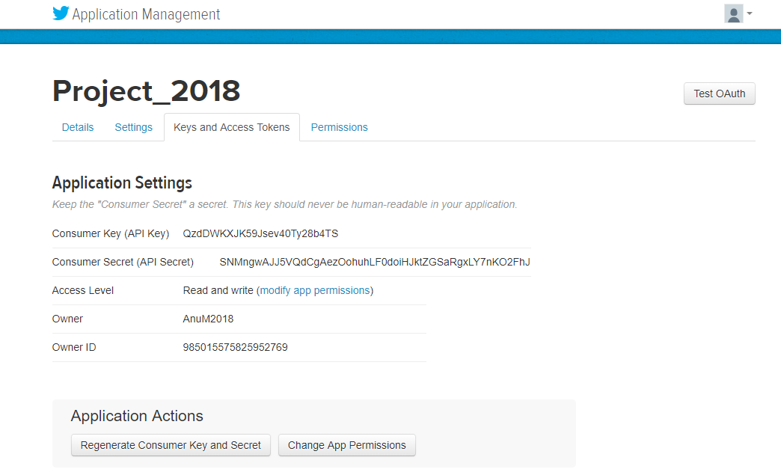
How to Straem twitter data

Slide 8
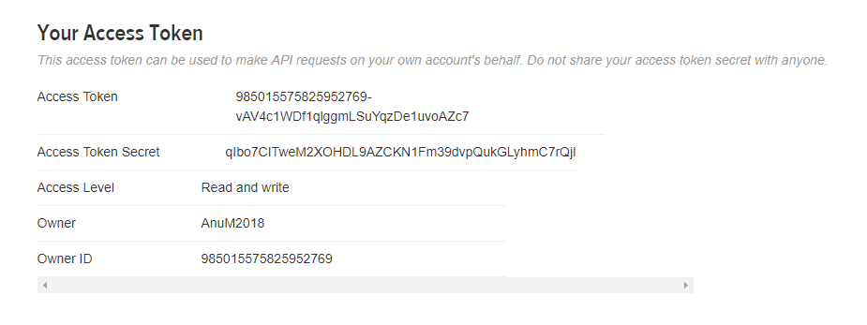
Continue…

Slide 9
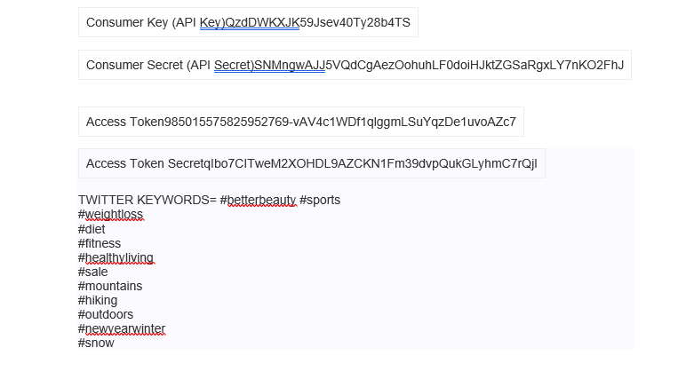

Slide 10
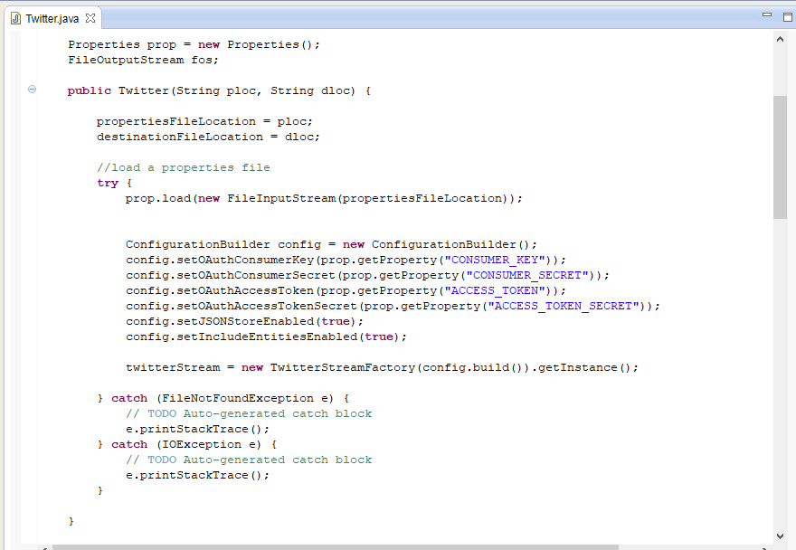
Continue..

Slide 11
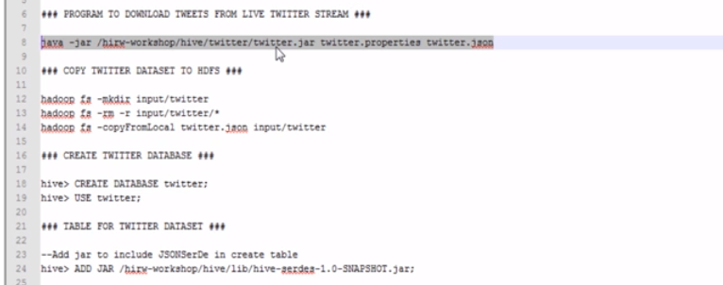

Slide 12
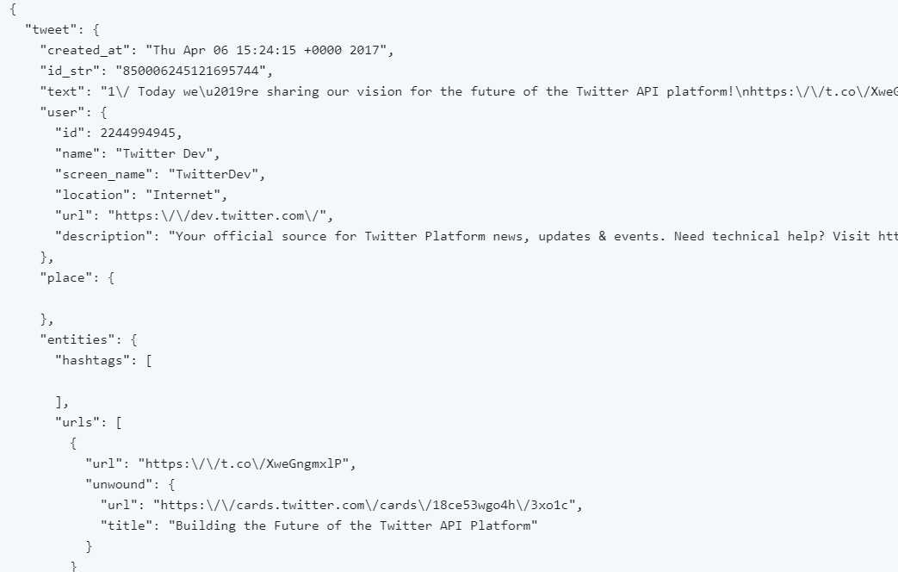
Data cleaning
Data in JSON format

Slide 13
Load data in Hive
Create table structure in Hive
Three main elements
Text : Actual Tweet text.
Entity: Hashtag
User: User information
Gender
Tweet Source
State

Slide 14
Data Analysis
Top 10 trending hashtags in each State
Tweet from different sources
Most number of user tweeted
Derive sentiment rating

Slide 15
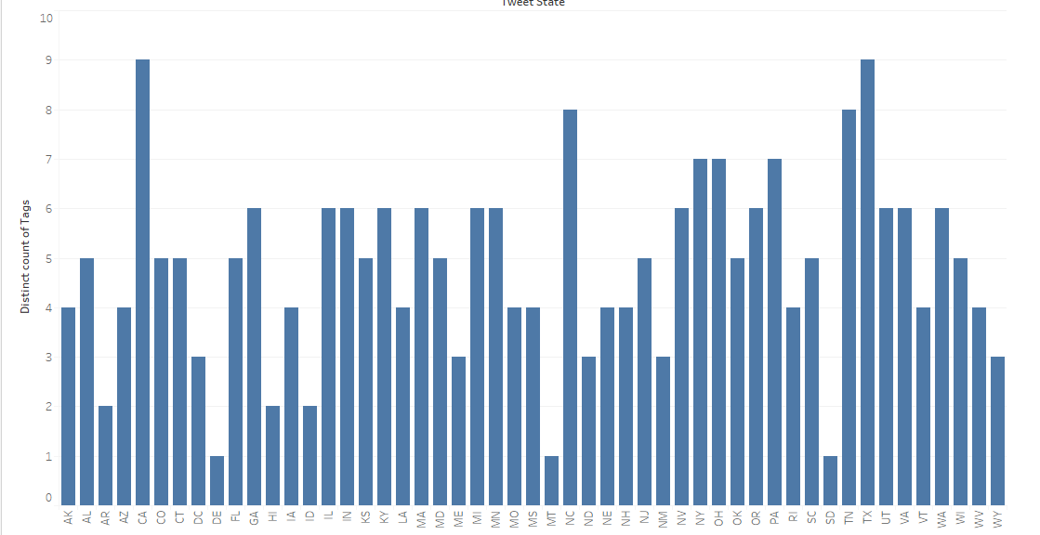
Results

Slide 16
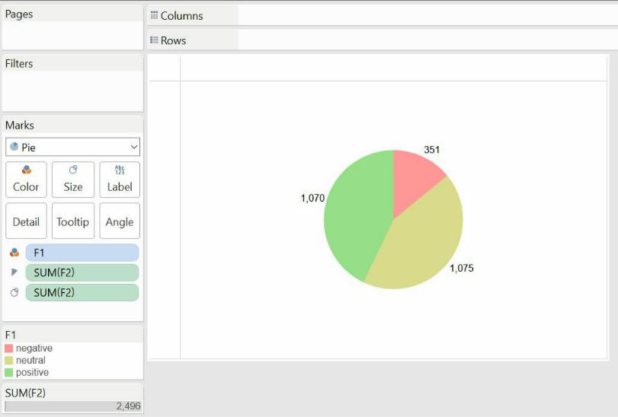
Sentiment analysis

Slide 17
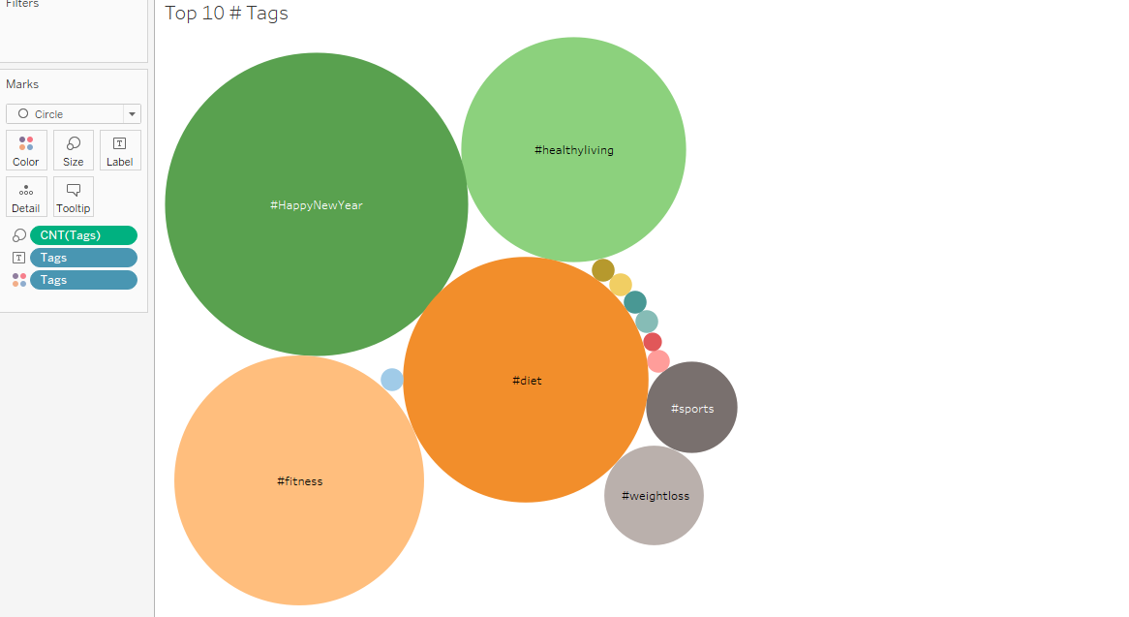
Top 10 # tags

Slide 18
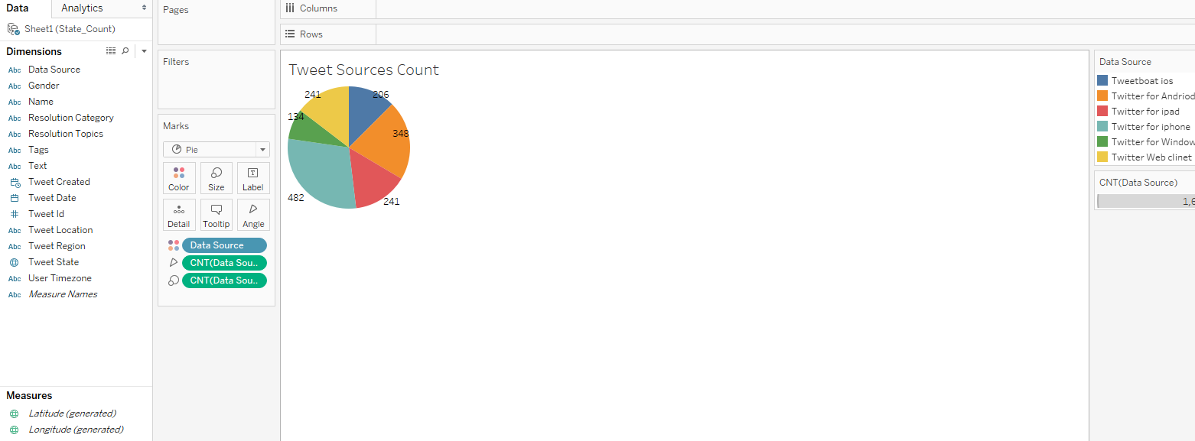
Sources of tweet

Slide 19
Gantt chart

Slide 20
Thank you!

